Slide 1

BuffsFTW Team #22
Evan Yin, Blake Galbavy, Fatin Kamaruzaman, Adam Austin,
Jack Panetta, Sterling Vangeloff
Notes:
Evan: Project Manager
Adam: Database Designer
Jack: Web Developer
Blake: Android Developer
Fatin: Android Developer

Slide 2


Inspiration
Problem:
Skaters...
- Want to explore new spots
- Aren’t always in their home city
Vision Statement:
To connect skateboarders and BMXers to unknown locations within their geographic proximity.
Notes:
Blake
The Inspiration for this app was the problem that…..
Skaters get bored of the spots that they know
And Skaters could be traveling and want to find new spots.
These problems led us to the vision To connect skateboarders and BMXers…..

Slide 3





Solution - SkateSpots
Map based app connecting skaters to local skate spots
User-Populated map
All spots contributed by users
Contribution
Submit spots to receive tokens
Collection
Spend tokens to collect spots
Diversify your skating experience!
Notes:
Adam

Slide 4

Industry Landscape
Market
Skateboarding market = $4.8 Billion in annual revenue
11.1 Million active skateboarders in the world.
What makes us different?
Map population - Manual Population vs User Drive Population
Worldwide capabilities
Spots can be earned in addition to being purchased
Easy-To-Use UI
Notes:
Evan
No money spent on creating the locations makes it cheaper for everyone.
Unlimited range because there are people everywhere + google maps api makes around the world coordinates available.
User doesn’t have to pay for anything if they don’t want to.
Easy UI in Demo.

Slide 5




How did we do it?
Methodology - Agile
Two Standups per Week
Bi-Weekly Retrospective
Project Management
Slack
Trello
GitHub
Software Frameworks
Android (Java)
ASP.NET 4.5 (C#)
Microsoft SQL Server (T-SQL)
Notes:
Jack

Slide 6
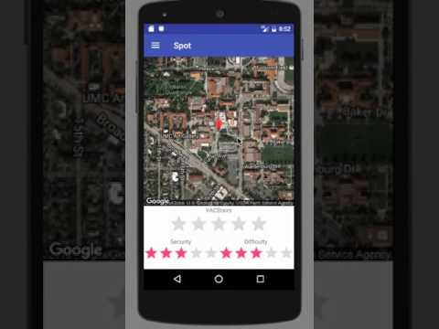
See for yourself...
Notes:
Fatin

Slide 7



Going Forward
Security
Encrypt user information
Spot Albums
Allow users to upload pictures at the spot
Monetization
In-App user targeted ads
Sale of token bundles
Rating Algorithm
Rank users based on contribution
Notes:
Sterling (Adam if he’s MIA)

